Slide 1
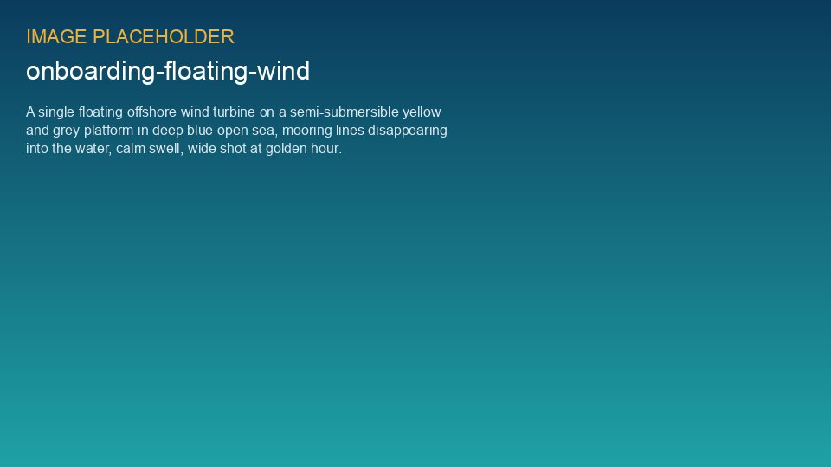
WEYLAND ENERGY
Floating Offshore Wind 101
Lunch & Learn · Sofie Lindqvist · 12 February 2026

Slide 2
Why floating?
• Fixed-bottom foundations (like our 9.5 m monopiles at Harrow Bay) work to ~ 50–60 m water depth
• Much of the best wind resource in Europe is in deeper water
• Floating platforms open up new areas further from shore – less visual impact
WEYLAND ENERGY · Floating Offshore Wind 101
2
Notes:
Start with a question to the room: how deep is Harrow Bay? (28–36 m)

Slide 3
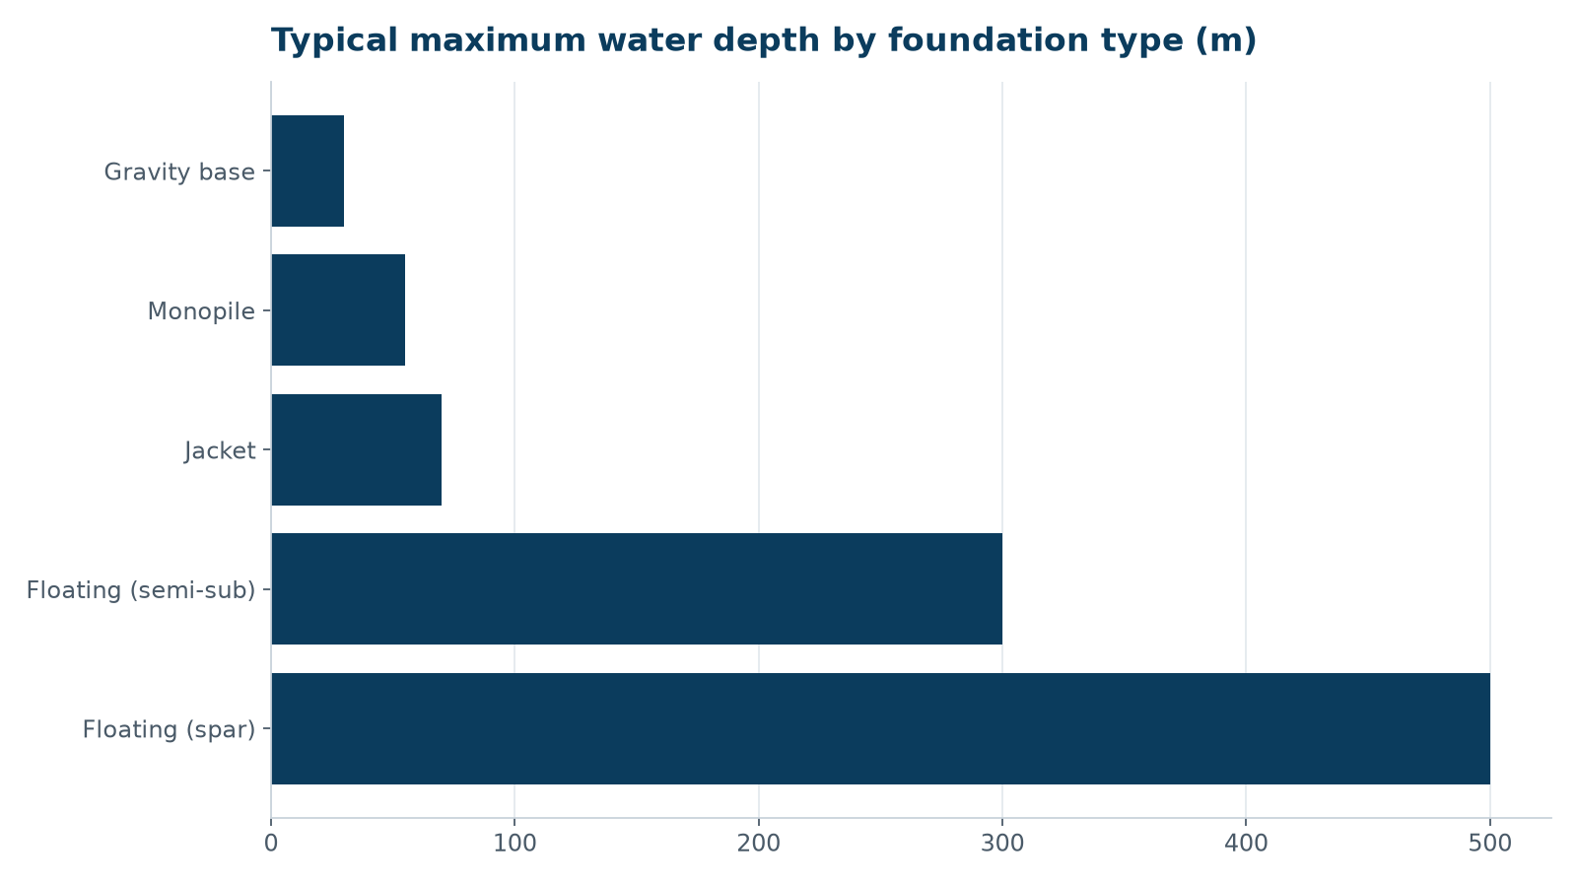
Foundation types vs water depth
WEYLAND ENERGY · Floating Offshore Wind 101
3

Slide 4
Three main platform concepts
Concept | How it floats | Pros | Cons
Spar buoy | Deep ballasted cylinder | Very stable | Needs > 100 m depth and deep ports
Semi-submersible | Three or four columns with pontoons | Assembled in port, towed out | Large steel volume
Tension leg platform | Buoyant hull pulled down by taut tendons | Small footprint | Complex installation
WEYLAND ENERGY · Floating Offshore Wind 101
4

Slide 5
Moorings and dynamic cables
• Mooring lines: chain, steel wire or synthetic rope, anchored with drag or suction anchors
• Dynamic array cables hang in a lazy-wave shape to follow platform motion
• Fatigue of moorings and cables is the key design driver
WEYLAND ENERGY · Floating Offshore Wind 101
5

Slide 6
What it means for Weyland
• No floating project in our pipeline today
• Copenhagen engineering team follows Scottish and Norwegian leasing rounds
• Harrow Bay experience (HTS-12 turbines, Port of Eastholm) is directly transferable
WEYLAND ENERGY · Floating Offshore Wind 101
6
Notes:
Henrik Larsen (Business Development) can say more about leasing rounds.

Slide 7
WEYLAND ENERGY
Questions?
Recording and slides in the Lunch & Learn library

